Slide 1
Chapter 2
Instructions: Language of the Computer

Slide 2
Instruction Set
§2.1 Introduction
The repertoire of instructions of a computer
Different computers have different instruction sets
But with many aspects in common
Early computers had very simple instruction sets
Simplified implementation
Many modern computers also have simple instruction sets

Slide 3
The MIPS Instruction Set
Used as the example throughout the book
Stanford MIPS commercialized by MIPS Technologies (www.mips.com)
Large share of embedded core market
Applications in consumer electronics, network/storage equipment, cameras, printers, …
Typical of many modern ISAs
See MIPS Reference Data tear-out card, and Appendixes B and E

Slide 4
Arithmetic Operations
Add and subtract, three operands
Two sources and one destination
add a, b, c # a gets b + c
All arithmetic operations have this form
Design Principle 1: Simplicity favours regularity
Regularity makes implementation simpler
Simplicity enables higher performance at lower cost
§2.2 Operations of the Computer Hardware

Slide 5
Arithmetic Example
C code:
f = (g + h) - (i + j);
Compiled MIPS code:
add t0, g, h # temp t0 = g + h add t1, i, j # temp t1 = i + j sub f, t0, t1 # f = t0 - t1

Slide 6
Register Operands
Arithmetic instructions use register operands
MIPS has a 32 × 32-bit register file
Use for frequently accessed data
Numbered 0 to 31
32-bit data called a “word”
Assembler names
$t0, $t1, …, $t9 for temporary values
$s0, $s1, …, $s7 for saved variables
Design Principle 2: Smaller is faster
c.f. main memory: millions of locations
§2.3 Operands of the Computer Hardware

Slide 7
Register Operand Example
C code:
f = (g + h) - (i + j);
f, …, j in $s0, …, $s4
Compiled MIPS code:
add $t0, $s1, $s2 add $t1, $s3, $s4 sub $s0, $t0, $t1

Slide 8
Memory Operands
Main memory used for composite data
Arrays, structures, dynamic data
To apply arithmetic operations
Load values from memory into registers
Store result from register to memory
Memory is byte addressed
Each address identifies an 8-bit byte
Words are aligned in memory
Address must be a multiple of 4
MIPS is Big Endian
Most-significant byte at least address of a word
c.f. Little Endian: least-significant byte at least address

Slide 9

Memory Operand Example 1
C code:
g = h + A[8];
g in $s1, h in $s2, base address of A in $s3
Compiled MIPS code:
Index 8 requires offset of 32
4 bytes per word
lw $t0, 32($s3) # load word add $s1, $s2, $t0
offset
base register
Notes:
Add $s1 $s2 is backwards

Slide 10
Memory Operand Example 2
C code:
A[12] = h + A[8];
h in $s2, base address of A in $s3
Compiled MIPS code:
Index 8 requires offset of 32
lw $t0, 32($s3) # load word add $t0, $s2, $t0 sw $t0, 48($s3) # store word

Slide 11
Registers vs. Memory
Registers are faster to access than memory
Operating on memory data requires loads and stores
More instructions to be executed
Compiler must use registers for variables as much as possible
Only spill to memory for less frequently used variables
Register optimization is important!

Slide 12
Immediate Operands
Constant data specified in an instruction
addi $s3, $s3, 4
No subtract immediate instruction
Just use a negative constant
addi $s2, $s1, -1
Design Principle 3: Make the common case fast
Small constants are common
Immediate operand avoids a load instruction

Slide 13
The Constant Zero
MIPS register 0 ($zero) is the constant 0
Cannot be overwritten
Useful for common operations
E.g., move between registers
add $t2, $s1, $zero

Slide 14
Unsigned Binary Integers
Given an n-bit number
§2.4 Signed and Unsigned Numbers
Range: 0 to +2^{n} – 1
Example
0000 0000 0000 0000 0000 0000 0000 1011₂ = 0 + … + 1×2³ + 0×2² +1×2¹ +1×2⁰ = 0 + … + 8 + 0 + 2 + 1 = 11₁₀
Using 32 bits
0 to +4,294,967,295

Slide 15
2s-Complement Signed Integers
Given an n-bit number
Range: –2^{n – 1} to +2^{n – 1} – 1
Example
1111 1111 1111 1111 1111 1111 1111 1100₂ = –1×2³¹ + 1×2³⁰ + … + 1×2² +0×2¹ +0×2⁰ = –2,147,483,648 + 2,147,483,644 = –4₁₀
Using 32 bits
–2,147,483,648 to +2,147,483,647
Notes:
2’s complement – flip all bits (that’s 1’s complement) and then add 1

Slide 16
2s-Complement Signed Integers
Bit 31 is sign bit
1 for negative numbers
0 for non-negative numbers
–(–2^{n – 1}) can’t be represented
Non-negative numbers have the same unsigned and 2s-complement representation
Some specific numbers
0: 0000 0000 … 0000
–1: 1111 1111 … 1111
Most-negative: 1000 0000 … 0000
Most-positive: 0111 1111 … 1111

Slide 17
Signed Negation
Complement and add 1
Complement means 1 → 0, 0 → 1
Example: negate +2
+2 = 0000 0000 … 0010₂
–2 = 1111 1111 … 1101₂ + 1 = 1111 1111 … 1110₂

Slide 18
Sign Extension
Representing a number using more bits
Preserve the numeric value
In MIPS instruction set
addi: extend immediate value
lb, lh: extend loaded byte/halfword
beq, bne: extend the displacement
Replicate the sign bit to the left
c.f. unsigned values: extend with 0s
Examples: 8-bit to 16-bit
+2: 0000 0010 => 0000 0000 0000 0010
–2: 1111 1110 => 1111 1111 1111 1110

Slide 19

Representing Instructions
Instructions are encoded in binary
Called machine code
MIPS instructions
Encoded as 32-bit instruction words
Small number of formats encoding operation code (opcode), register numbers, …
Regularity!
Register numbers
$t0 – $t7 are reg’s 8 – 15
$t8 – $t9 are reg’s 24 – 25
$s0 – $s7 are reg’s 16 – 23
§2.5 Representing Instructions in the Computer

Slide 20
MIPS R-format Instructions
op
rs
rt
rd
shamt
funct
6 bits
5 bits
5 bits
5 bits
5 bits
6 bits
Instruction fields
op: operation code (opcode)
rs: first source register number
rt: second source register number
rd: destination register number
shamt: shift amount (00000 for now)
funct: function code (extends opcode)

Slide 21
R-format Example
op
rs
rt
rd
shamt
funct
6 bits
5 bits
5 bits
5 bits
5 bits
6 bits
add $t0, $s1, $s2
special
$s1
$s2
$t0
0
add
0
17
18
8
0
32
000000
10001
10010
01000
00000
100000
00000010001100100100000000100000₂ = 02324020₁₆

Slide 22
Hexadecimal
Base 16
Compact representation of bit strings
4 bits per hex digit
0 | 0000 | 4 | 0100 | 8 | 1000 | c | 1100
1 | 0001 | 5 | 0101 | 9 | 1001 | d | 1101
2 | 0010 | 6 | 0110 | a | 1010 | e | 1110
3 | 0011 | 7 | 0111 | b | 1011 | f | 1111
Example: eca8 6420
1110 1100 1010 1000 0110 0100 0010 0000

Slide 23
MIPS I-format Instructions
op
rs
rt
constant or address
6 bits
5 bits
5 bits
16 bits
Immediate arithmetic and load/store instructions
rt: destination or source register number
Constant: –2¹⁵ to +2¹⁵ – 1
Address: offset added to base address in rs
Design Principle 4: Good design demands good compromises
Different formats complicate decoding, but allow 32-bit instructions uniformly
Keep formats as similar as possible

Slide 24
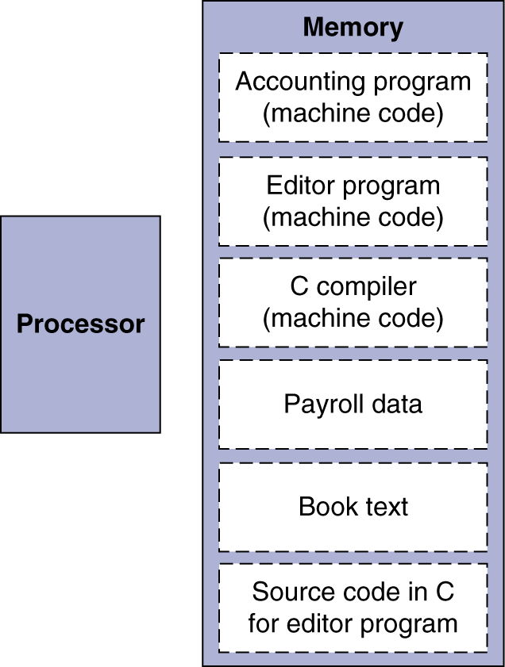
Stored Program Computers
The BIG Picture
Instructions represented in binary, just like data
Instructions and data stored in memory
Programs can operate on programs
e.g., compilers, linkers, …
Binary compatibility allows compiled programs to work on different computers
Standardized ISAs

Slide 25
Logical Operations
Instructions for bitwise manipulation
§2.6 Logical Operations
Operation | C | Java | MIPS
Shift left | << | << | sll
Shift right | >> | >>> | srl
Bitwise AND | & | & | and, andi
Bitwise OR | | | | | or, ori
Bitwise NOT | ~ | ~ | nor
Useful for extracting and inserting groups of bits in a word

Slide 26
Shift Operations
op
rs
rt
rd
shamt
funct
6 bits
5 bits
5 bits
5 bits
5 bits
6 bits
shamt: how many positions to shift
Shift left logical
Shift left and fill with 0 bits
sll by i bits multiplies by 2^{i}
Shift right logical
Shift right and fill with 0 bits
srl by i bits divides by 2^{i} (unsigned only)

Slide 27
AND Operations
Useful to mask bits in a word
Select some bits, clear others to 0
and $t0, $t1, $t2
$t2
0000 0000 0000 0000 0000 1101 1100 0000
$t1
0000 0000 0000 0000 0011 1100 0000 0000
$t0
0000 0000 0000 0000 0000 1100 0000 0000

Slide 28
OR Operations
Useful to include bits in a word
Set some bits to 1, leave others unchanged
or $t0, $t1, $t2
$t2
0000 0000 0000 0000 0000 1101 1100 0000
$t1
0000 0000 0000 0000 0011 1100 0000 0000
$t0
0000 0000 0000 0000 0011 1101 1100 0000

Slide 29
NOT Operations
Useful to invert bits in a word
Change 0 to 1, and 1 to 0
MIPS has NOR 3-operand instruction
a NOR b == NOT ( a OR b )
nor $t0, $t1, $zero
Register 0: always read as zero
$t1
0000 0000 0000 0000 0011 1100 0000 0000
$t0
1111 1111 1111 1111 1100 0011 1111 1111

Slide 30
Conditional Operations
Branch to a labeled instruction if a condition is true
Otherwise, continue sequentially
beq rs, rt, L1
if (rs == rt) branch to instruction labeled L1;
bne rs, rt, L1
if (rs != rt) branch to instruction labeled L1;
j L1
unconditional jump to instruction labeled L1
§2.7 Instructions for Making Decisions

Slide 31
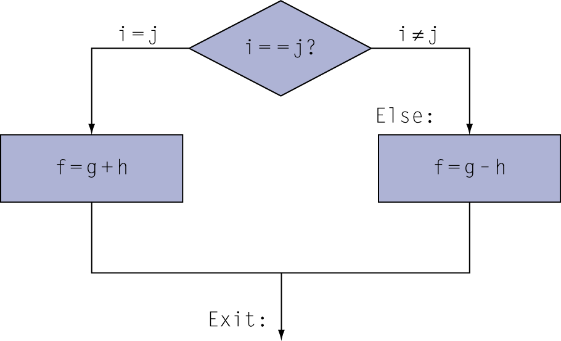
Compiling If Statements
C code:
if (i==j) f = g+h; else f = g-h;
f, g, … in $s0, $s1, …
Compiled MIPS code:
bne $s3, $s4, Else add $s0, $s1, $s2 j Exit Else: sub $s0, $s1, $s2 Exit: …
Assembler calculates addresses

Slide 32
Compiling Loop Statements
C code:
while (save[i] == k) i += 1;
i in $s3, k in $s5, address of save in $s6
Compiled MIPS code:
Loop: sll $t1, $s3, 2 add $t1, $t1, $s6 lw $t0, 0($t1) bne $t0, $s5, Exit addi $s3, $s3, 1 j Loop Exit: …

Slide 33
Basic Blocks
A basic block is a sequence of instructions with
No embedded branches (except at end)
No branch targets (except at beginning)
A compiler identifies basic blocks for optimization
An advanced processor can accelerate execution of basic blocks

Slide 34
More Conditional Operations
Set result to 1 if a condition is true
Otherwise, set to 0
slt rd, rs, rt
if (rs < rt) rd = 1; else rd = 0;
slti rt, rs, constant
if (rs < constant) rt = 1; else rt = 0;
Use in combination with beq, bne
slt $t0, $s1, $s2 # if ($s1 < $s2) bne $t0, $zero, L # branch to L

Slide 35
Branch Instruction Design
Why not blt, bge, etc?
Hardware for <, ≥, … slower than =, ≠
Combining with branch involves more work per instruction, requiring a slower clock
All instructions penalized!
beq and bne are the common case
This is a good design compromise

Slide 36
Signed vs. Unsigned
Signed comparison: slt, slti
Unsigned comparison: sltu, sltui
Example
$s0 = 1111 1111 1111 1111 1111 1111 1111 1111
$s1 = 0000 0000 0000 0000 0000 0000 0000 0001
slt $t0, $s0, $s1 # signed
–1 < +1 ⇒ $t0 = 1
sltu $t0, $s0, $s1 # unsigned
+4,294,967,295 > +1 ⇒ $t0 = 0

Slide 37
Procedure Calling
Steps required
Place parameters in registers
Transfer control to procedure
Acquire storage for procedure
Perform procedure’s operations
Place result in register for caller
Return to place of call
§2.8 Supporting Procedures in Computer Hardware

Slide 38
Register Usage
$a0 – $a3: arguments (reg’s 4 – 7)
$v0, $v1: result values (reg’s 2 and 3)
$t0 – $t9: temporaries
Can be overwritten by callee
$s0 – $s7: saved
Must be saved/restored by callee
$gp: global pointer for static data (reg 28)
$sp: stack pointer (reg 29)
$fp: frame pointer (reg 30)
$ra: return address (reg 31)

Slide 39
Procedure Call Instructions
Procedure call: jump and link
jal ProcedureLabel
Address of following instruction put in $ra
Jumps to target address
Procedure return: jump register
jr $ra
Copies $ra to program counter
Can also be used for computed jumps
e.g., for case/switch statements

Slide 40
Leaf Procedure Example
C code:
int leaf_example (int g, h, i, j) { int f; f = (g + h) - (i + j); return f; }
Arguments g, …, j in $a0, …, $a3
f in $s0 (hence, need to save $s0 on stack)
Result in $v0

Slide 41
Leaf Procedure Example
MIPS code:
leaf_example: addi $sp, $sp, -4 sw $s0, 0($sp) add $t0, $a0, $a1 add $t1, $a2, $a3 sub $s0, $t0, $t1 add $v0, $s0, $zero lw $s0, 0($sp) addi $sp, $sp, 4 jr $ra
Save $s0 on stack
Procedure body
Result
Restore $s0
Return

Slide 42
Non-Leaf Procedures
Procedures that call other procedures
For nested call, caller needs to save on the stack:
Its return address
Any arguments and temporaries needed after the call
Restore from the stack after the call

Slide 43
Non-Leaf Procedure Example
C code:
int fact (int n) { if (n < 1) return f; else return n * fact(n - 1); }
Argument n in $a0
Result in $v0

Slide 44
Non-Leaf Procedure Example
MIPS code:
fact: addi $sp, $sp, -8 # adjust stack for 2 items sw $ra, 4($sp) # save return address sw $a0, 0($sp) # save argument slti $t0, $a0, 1 # test for n < 1 beq $t0, $zero, L1 addi $v0, $zero, 1 # if so, result is 1 addi $sp, $sp, 8 # pop 2 items from stack jr $ra # and return L1: addi $a0, $a0, -1 # else decrement n jal fact # recursive call lw $a0, 0($sp) # restore original n lw $ra, 4($sp) # and return address addi $sp, $sp, 8 # pop 2 items from stack mul $v0, $a0, $v0 # multiply to get result jr $ra # and return

Slide 45
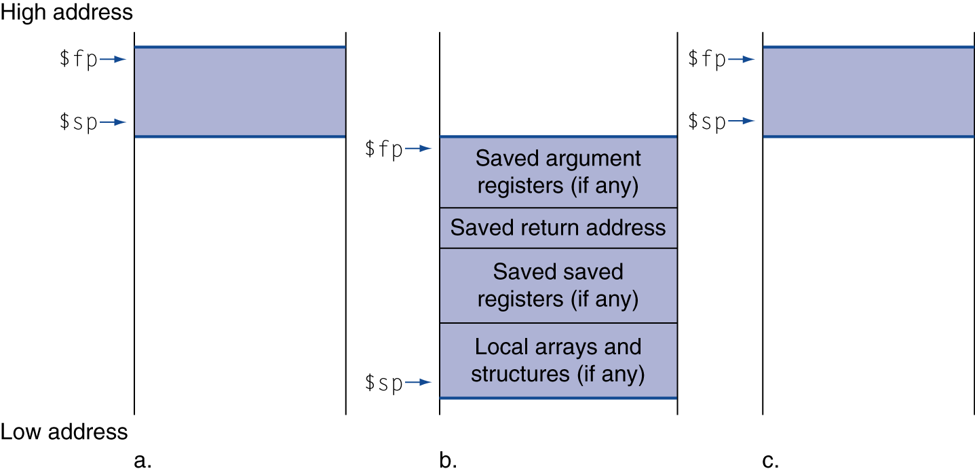
Local Data on the Stack
Local data allocated by callee
e.g., C automatic variables
Procedure frame (activation record)
Used by some compilers to manage stack storage

Slide 46
GOT HERE AFTER 2 HOURS in the past

Slide 47
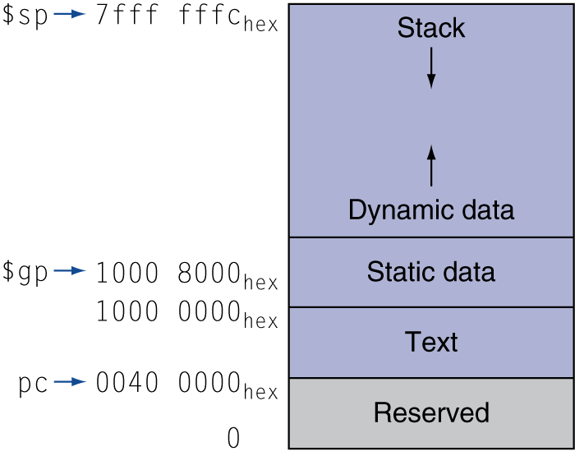
Memory Layout
Text: program code
Static data: global variables
e.g., static variables in C, constant arrays and strings
$gp initialized to address allowing ±offsets into this segment
Dynamic data: heap
E.g., malloc in C, new in Java
Stack: automatic storage

Slide 48
Character Data
Byte-encoded character sets
ASCII: 128 characters
95 graphic, 33 control
Latin-1: 256 characters
ASCII, +96 more graphic characters
Unicode: 32-bit character set
Used in Java, C++ wide characters, …
Most of the world’s alphabets, plus symbols
UTF-8, UTF-16: variable-length encodings
§2.9 Communicating with People

Slide 49
Byte/Halfword Operations
Could use bitwise operations
MIPS byte/halfword load/store
String processing is a common case
lb rt, offset(rs) lh rt, offset(rs)
Sign extend to 32 bits in rt
lbu rt, offset(rs) lhu rt, offset(rs)
Zero extend to 32 bits in rt
sb rt, offset(rs) sh rt, offset(rs)
Store just rightmost byte/halfword

Slide 50
String Copy Example
C code (naïve):
Null-terminated string
void strcpy (char x[], char y[]) { int i; i = 0; while ((x[i]=y[i])!='\0') i += 1; }
Addresses of x, y in $a0, $a1
i in $s0

Slide 51
String Copy Example
MIPS code:
strcpy: addi $sp, $sp, -4 # adjust stack for 1 item sw $s0, 0($sp) # save $s0 add $s0, $zero, $zero # i = 0 L1: add $t1, $s0, $a1 # addr of y[i] in $t1 lbu $t2, 0($t1) # $t2 = y[i] add $t3, $s0, $a0 # addr of x[i] in $t3 sb $t2, 0($t3) # x[i] = y[i] beq $t2, $zero, L2 # exit loop if y[i] == 0 addi $s0, $s0, 1 # i = i + 1 j L1 # next iteration of loop L2: lw $s0, 0($sp) # restore saved $s0 addi $sp, $sp, 4 # pop 1 item from stack jr $ra # and return
Notes:
SB: Store byte

Slide 52
32-bit Constants
Most constants are small
16-bit immediate is sufficient
For the occasional 32-bit constant
lui rt, constant
Copies 16-bit constant to left 16 bits of rt
Clears right 16 bits of rt to 0
§2.10 MIPS Addressing for 32-Bit Immediates and Addresses
lhi $s0, 61
0000 0000 0111 1101 0000 0000 0000 0000
ori $s0, $s0, 2304
0000 0000 0111 1101 0000 1001 0000 0000
Notes:
Lui: Load up immediate

Slide 53
Branch Addressing
Branch instructions specify
Opcode, two registers, target address
Most branch targets are near branch
Forward or backward
op
rs
rt
constant or address
6 bits
5 bits
5 bits
16 bits
PC-relative addressing
Target address = PC + offset × 4
PC already incremented by 4 by this time

Slide 54
Jump Addressing
Jump (j and jal) targets could be anywhere in text segment
Encode full address in instruction
op
address
6 bits
26 bits
(Pseudo)Direct jump addressing
Target address = PC_{31…28} : (address × 4)

Slide 55
Target Addressing Example
Loop code from earlier example
Assume Loop at location 80000
Loop: sll $t1, $s3, 2 | 80000 | 0 | 0 | 19 | 9 | 4 | 0
add $t1, $t1, $s6 | 80004 | 0 | 9 | 22 | 9 | 0 | 32
lw $t0, 0($t1) | 80008 | 35 | 9 | 8 | 0
bne $t0, $s5, Exit | 80012 | 5 | 8 | 21 | 2
addi $s3, $s3, 1 | 80016 | 8 | 19 | 19 | 1
j Loop | 80020 | 2 | 20000
Exit: … | 80024

Slide 56
Branching Far Away
If branch target is too far to encode with 16-bit offset, assembler rewrites the code
Example
beq $s0,$s1, L1
↓
bne $s0,$s1, L2 j L1 L2: …

Slide 57
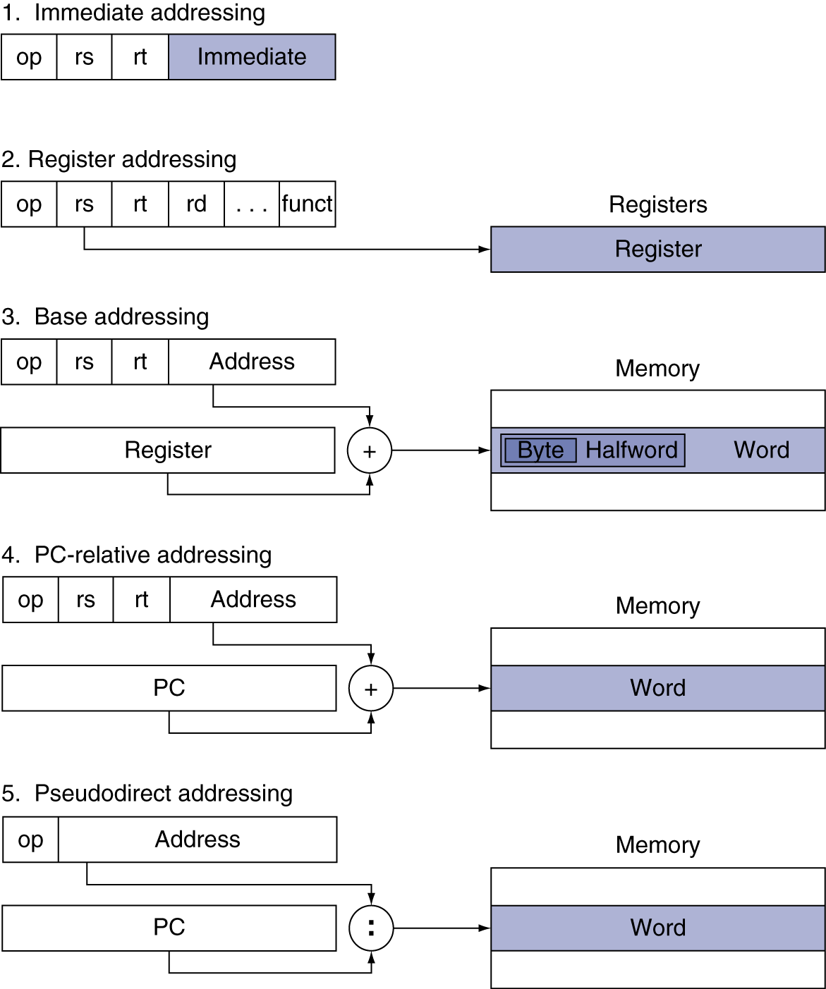
Addressing Mode Summary

Slide 58
Sri note
That previous slide is far more profoundly important than it gives itself credit for
We’ll come back to the concept a bit over the course but different addressing modes are pretty important

Slide 59
Synchronization
Two processors sharing an area of memory
P1 writes, then P2 reads
Data race if P1 and P2 don’t synchronize
Result depends of order of accesses
Hardware support required
Atomic read/write memory operation
No other access to the location allowed between the read and write
Could be a single instruction
E.g., atomic swap of register ↔ memory
Or an atomic pair of instructions
§2.11 Parallelism and Instructions: Synchronization

Slide 60
Synchronization in MIPS
Load linked: ll rt, offset(rs)
Store conditional: sc rt, offset(rs)
Succeeds if location not changed since the ll
Returns 1 in rt
Fails if location is changed
Returns 0 in rt
Example: atomic swap (to test/set lock variable)
try: add $t0,$zero,$s4 ;copy exchange value
ll $t1,0($s1) ;load linked
sc $t0,0($s1) ;store conditional
beq $t0,$zero,try ;branch store fails
add $s4,$zero,$t1 ;put load value in $s4

Slide 61
MARS sychronisation
MARS doesn’t actually simulate multiple processors
And while we acknowledge the concept, synchronisation and parallelism are a bit beyond where we expect you to be in 2nd year
Nor is it all that helpful to worry about the problem at the assembly level

Slide 62
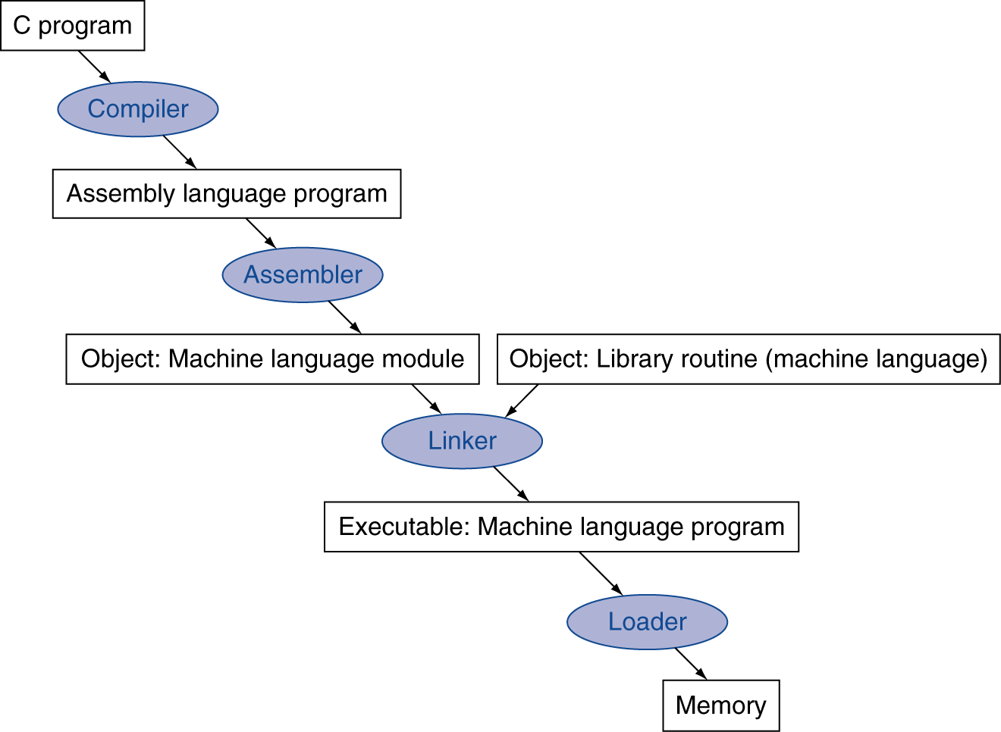
Translation and Startup
Many compilers produce object modules directly
§2.12 Translating and Starting a Program
Static linking

Slide 63
Assembler Pseudoinstructions
Most assembler instructions represent machine instructions one-to-one
Pseudoinstructions: figments of the assembler’s imagination
move $t0, $t1 → add $t0, $zero, $t1
blt $t0, $t1, L → slt $at, $t0, $t1 bne $at, $zero, L
$at (register 1): assembler temporary

Slide 64
Producing an Object Module
Assembler (or compiler) translates program into machine instructions
Provides information for building a complete program from the pieces
Header: described contents of object module
Text segment: translated instructions
Static data segment: data allocated for the life of the program
Relocation info: for contents that depend on absolute location of loaded program
Symbol table: global definitions and external refs
Debug info: for associating with source code

Slide 65
Linking Object Modules
Produces an executable image
1. Merges segments
2. Resolve labels (determine their addresses)
3. Patch location-dependent and external refs
Could leave location dependencies for fixing by a relocating loader
But with virtual memory, no need to do this
Program can be loaded into absolute location in virtual memory space

Slide 66
Loading a Program
Load from image file on disk into memory
1. Read header to determine segment sizes
2. Create virtual address space
3. Copy text and initialized data into memory
Or set page table entries so they can be faulted in
4. Set up arguments on stack
5. Initialize registers (including $sp, $fp, $gp)
6. Jump to startup routine
Copies arguments to $a0, … and calls main
When main returns, do exit syscall

Slide 67
Dynamic Linking
Only link/load library procedure when it is called
Requires procedure code to be relocatable
Avoids image bloat caused by static linking of all (transitively) referenced libraries
Automatically picks up new library versions

Slide 68
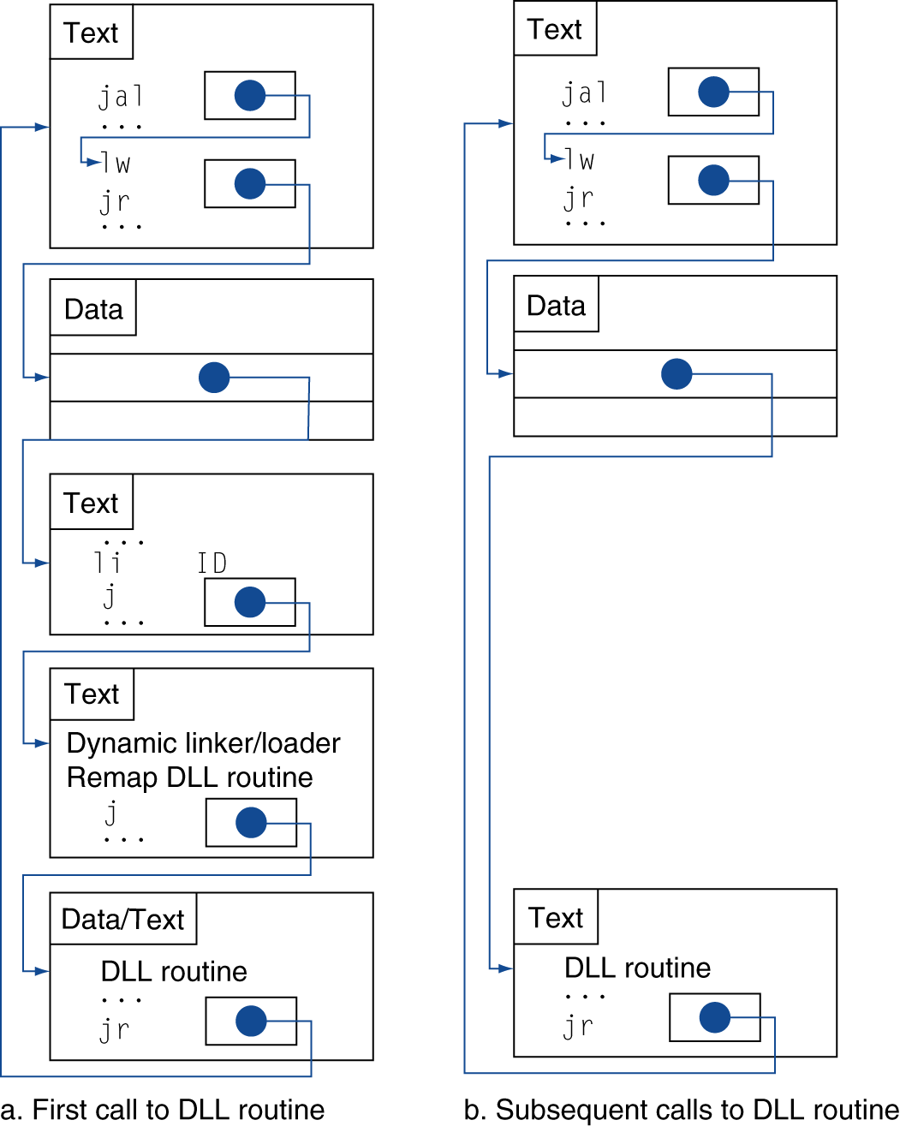
Lazy Linkage
Indirection table
Stub: Loads routine ID, Jump to linker/loader
Linker/loader code
Dynamically mapped code

Slide 69
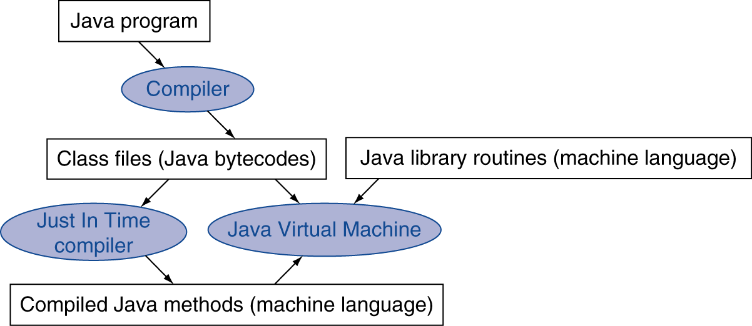
Starting Java Applications
Simple portable instruction set for the JVM
Compiles bytecodes of “hot” methods into native code for host machine
Interprets bytecodes

Slide 70
C Sort Example
Illustrates use of assembly instructions for a C bubble sort function
Swap procedure (leaf)
void swap(int v[], int k) { int temp; temp = v[k]; v[k] = v[k+1]; v[k+1] = temp; }
v in $a0, k in $a1, temp in $t0
§2.13 A C Sort Example to Put It All Together

Slide 71
The Procedure Swap
swap: sll $t1, $a1, 2 # $t1 = k * 4
add $t1, $a0, $t1 # $t1 = v+(k*4)
# (address of v[k])
lw $t0, 0($t1) # $t0 (temp) = v[k]
lw $t2, 4($t1) # $t2 = v[k+1]
sw $t2, 0($t1) # v[k] = $t2 (v[k+1])
sw $t0, 4($t1) # v[k+1] = $t0 (temp)
jr $ra # return to calling routine

Slide 72
The Sort Procedure in C
Non-leaf (calls swap)
void sort (int v[], int n)
{
int i, j;
for (i = 0; i < n; i += 1) {
for (j = i – 1;
j >= 0 && v[j] > v[j + 1];
j -= 1) {
swap(v,j);
}
}
}
v in $a0, k in $a1, i in $s0, j in $s1

Slide 73
The Procedure Body
move $s2, $a0 # save $a0 into $s2
move $s3, $a1 # save $a1 into $s3
move $s0, $zero # i = 0
for1tst: slt $t0, $s0, $s3 # $t0 = 0 if $s0 ≥ $s3 (i ≥ n)
beq $t0, $zero, exit1 # go to exit1 if $s0 ≥ $s3 (i ≥ n)
addi $s1, $s0, –1 # j = i – 1
for2tst: slti $t0, $s1, 0 # $t0 = 1 if $s1 < 0 (j < 0)
bne $t0, $zero, exit2 # go to exit2 if $s1 < 0 (j < 0)
sll $t1, $s1, 2 # $t1 = j * 4
add $t2, $s2, $t1 # $t2 = v + (j * 4)
lw $t3, 0($t2) # $t3 = v[j]
lw $t4, 4($t2) # $t4 = v[j + 1]
slt $t0, $t4, $t3 # $t0 = 0 if $t4 ≥ $t3
beq $t0, $zero, exit2 # go to exit2 if $t4 ≥ $t3
move $a0, $s2 # 1st param of swap is v (old $a0)
move $a1, $s1 # 2nd param of swap is j
jal swap # call swap procedure
addi $s1, $s1, –1 # j –= 1
j for2tst # jump to test of inner loop
exit2: addi $s0, $s0, 1 # i += 1
j for1tst # jump to test of outer loop
Move params
Outer loop
Inner loop
Pass params & call
Inner loop
Outer loop

Slide 74
The Full Procedure
sort: addi $sp,$sp, –20 # make room on stack for 5 registers
sw $ra, 16($sp) # save $ra on stack
sw $s3,12($sp) # save $s3 on stack
sw $s2, 8($sp) # save $s2 on stack
sw $s1, 4($sp) # save $s1 on stack
sw $s0, 0($sp) # save $s0 on stack
… # procedure body
…
exit1: lw $s0, 0($sp) # restore $s0 from stack
lw $s1, 4($sp) # restore $s1 from stack
lw $s2, 8($sp) # restore $s2 from stack
lw $s3,12($sp) # restore $s3 from stack
lw $ra,16($sp) # restore $ra from stack
addi $sp,$sp, 20 # restore stack pointer
jr $ra # return to calling routine

Slide 75
Effect of Compiler Optimization
Compiled with gcc for Pentium 4 under Linux

Slide 76
Effect of Language and Algorithm

Slide 77
Lessons Learnt
Instruction count and CPI are not good performance indicators in isolation
Compiler optimizations are sensitive to the algorithm
Java/JIT compiled code is significantly faster than JVM interpreted
Comparable to optimized C in some cases
Nothing can fix a dumb algorithm!

Slide 78
Arrays vs. Pointers
Array indexing involves
Multiplying index by element size
Adding to array base address
Pointers correspond directly to memory addresses
Can avoid indexing complexity
§2.14 Arrays versus Pointers

Slide 79
Example: Clearing and Array
clear1(int array[], int size) { int i; for (i = 0; i < size; i += 1) array[i] = 0; } | clear2(int *array, int size) { int *p; for (p = &array[0]; p < &array[size]; p = p + 1) *p = 0; }
move $t0,$zero # i = 0 loop1: sll $t1,$t0,2 # $t1 = i * 4 add $t2,$a0,$t1 # $t2 = # &array[i] sw $zero, 0($t2) # array[i] = 0 addi $t0,$t0,1 # i = i + 1 slt $t3,$t0,$a1 # $t3 = # (i < size) bne $t3,$zero,loop1 # if (…) # goto loop1 | move $t0,$a0 # p = & array[0] sll $t1,$a1,2 # $t1 = size * 4 add $t2,$a0,$t1 # $t2 = # &array[size] loop2: sw $zero,0($t0) # Memory[p] = 0 addi $t0,$t0,4 # p = p + 4 slt $t3,$t0,$t2 # $t3 = #(p<&array[size]) bne $t3,$zero,loop2 # if (…) # goto loop2

Slide 80
Comparison of Array vs. Ptr
Multiply “strength reduced” to shift
Array version requires shift to be inside loop
Part of index calculation for incremented i
c.f. incrementing pointer
Compiler can achieve same effect as manual use of pointers
Induction variable elimination
Better to make program clearer and safer

Slide 81
ARM & MIPS Similarities
ARM: the most popular embedded core
Similar basic set of instructions to MIPS
§2.16 Real Stuff: ARM Instructions
 | ARM | MIPS
Date announced | 1985 | 1985
Instruction size | 32 bits | 32 bits
Address space | 32-bit flat | 32-bit flat
Data alignment | Aligned | Aligned
Data addressing modes | 9 | 3
Registers | 15 × 32-bit | 31 × 32-bit
Input/output | Memory mapped | Memory mapped

Slide 82
Compare and Branch in ARM
Uses condition codes for result of an arithmetic/logical instruction
Negative, zero, carry, overflow
Compare instructions to set condition codes without keeping the result
Each instruction can be conditional
Top 4 bits of instruction word: condition value
Can avoid branches over single instructions

Slide 83
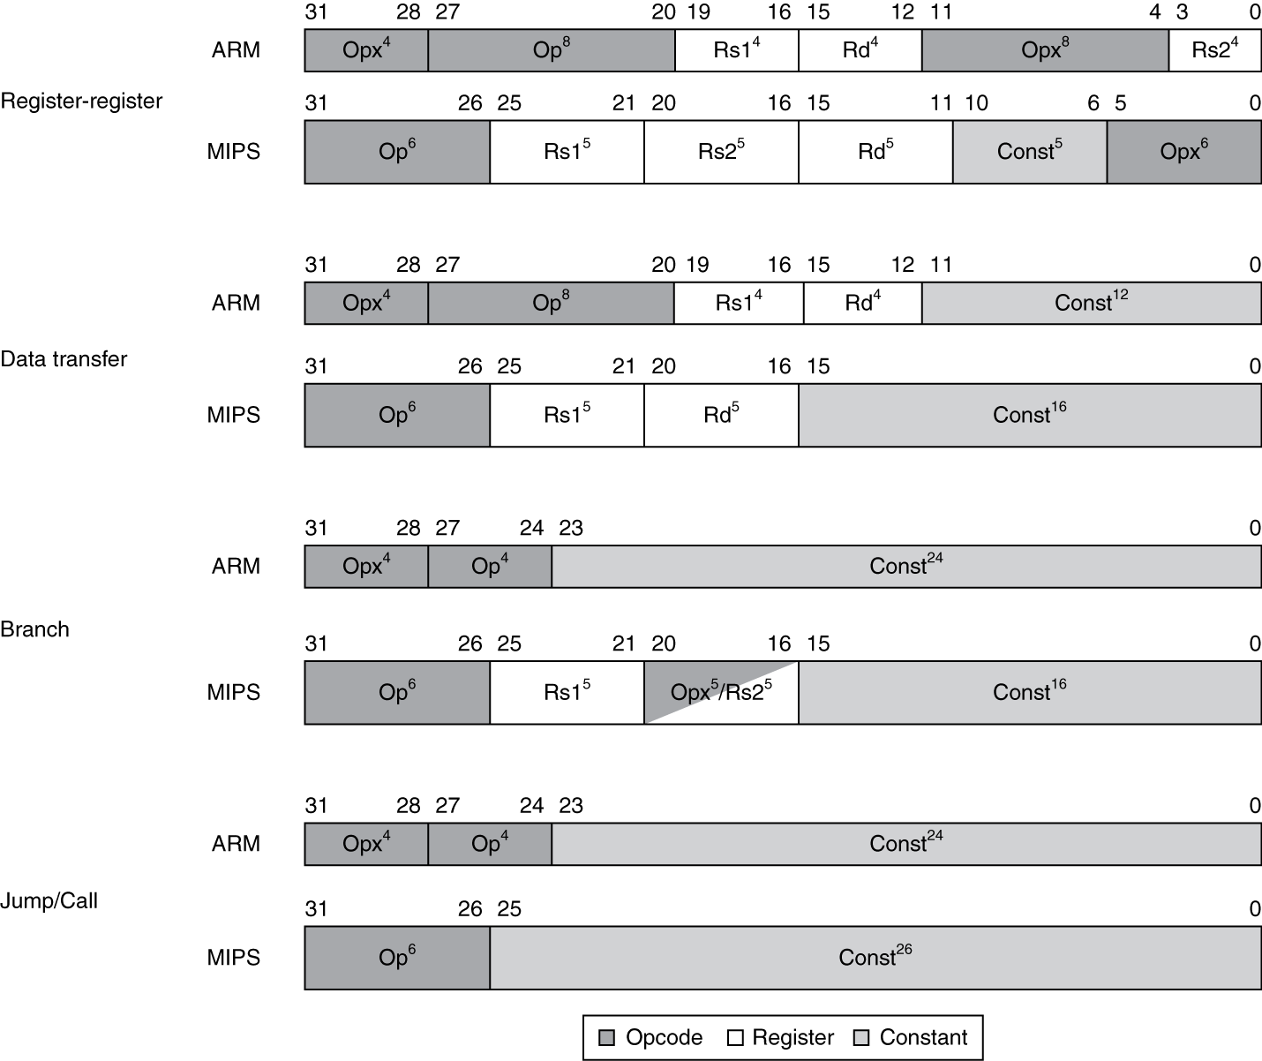
Instruction Encoding

Slide 84
The Intel x86 ISA
Evolution with backward compatibility
8080 (1974): 8-bit microprocessor
Accumulator, plus 3 index-register pairs
8086 (1978): 16-bit extension to 8080
Complex instruction set (CISC)
8087 (1980): floating-point coprocessor
Adds FP instructions and register stack
80286 (1982): 24-bit addresses, MMU
Segmented memory mapping and protection
80386 (1985): 32-bit extension (now IA-32)
Additional addressing modes and operations
Paged memory mapping as well as segments
§2.17 Real Stuff: x86 Instructions

Slide 85
The Intel x86 ISA
Further evolution…
i486 (1989): pipelined, on-chip caches and FPU
Compatible competitors: AMD, Cyrix, …
Pentium (1993): superscalar, 64-bit datapath
Later versions added MMX (Multi-Media eXtension) instructions
The infamous FDIV bug
Pentium Pro (1995), Pentium II (1997)
New microarchitecture (see Colwell, The Pentium Chronicles)
Pentium III (1999)
Added SSE (Streaming SIMD Extensions) and associated registers
Pentium 4 (2001)
New microarchitecture
Added SSE2 instructions

Slide 86
The Intel x86 ISA
And further…
AMD64 (2003): extended architecture to 64 bits
EM64T – Extended Memory 64 Technology (2004)
AMD64 adopted by Intel (with refinements)
Added SSE3 instructions
Intel Core (2006)
Added SSE4 instructions, virtual machine support
AMD64 (announced 2007): SSE5 instructions
Intel declined to follow, instead…
Advanced Vector Extension (announced 2008)
Longer SSE registers, more instructions
If Intel didn’t extend with compatibility, its competitors would!
Technical elegance ≠ market success

Slide 87
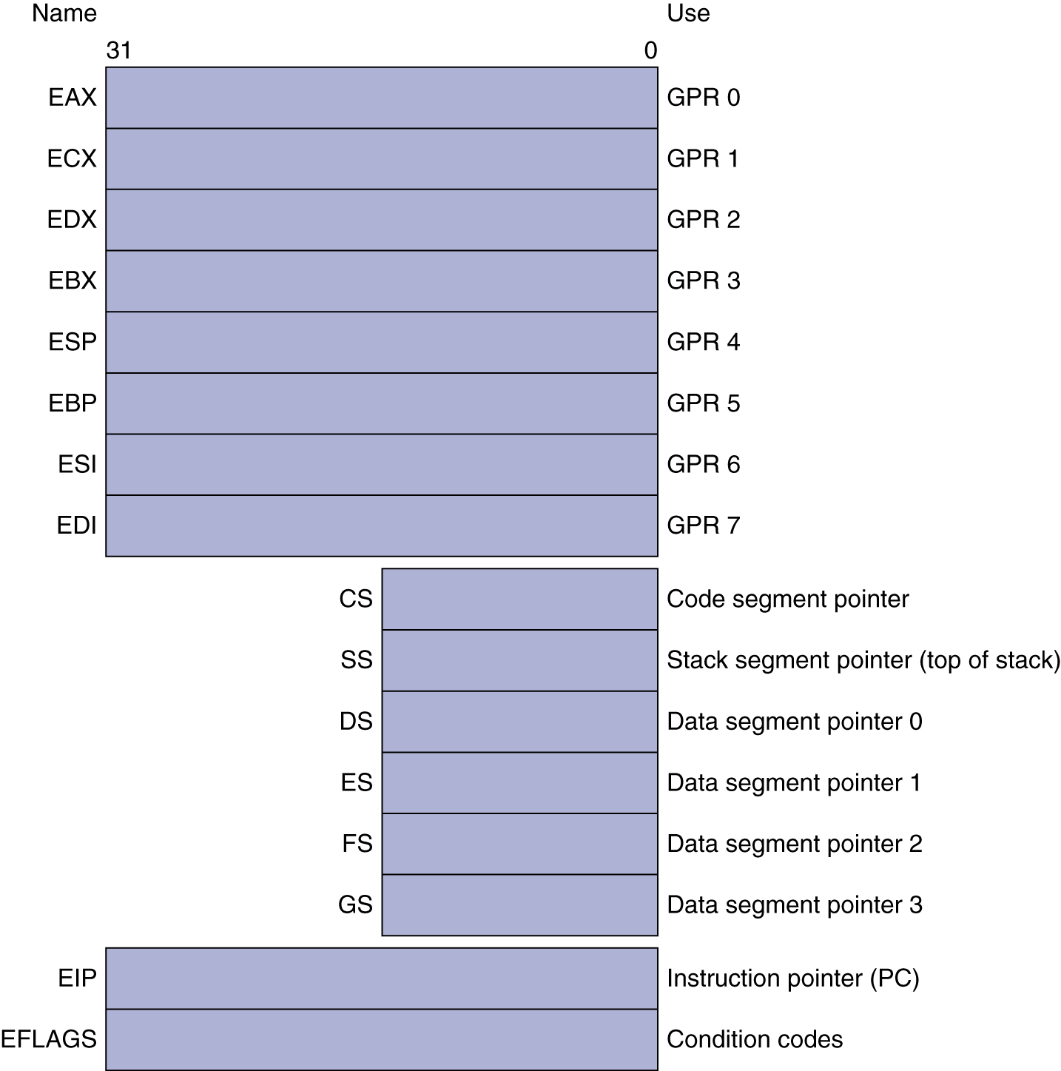
Basic x86 Registers

Slide 88
Basic x86 Addressing Modes
Two operands per instruction
Source/dest operand | Second source operand
Register | Register
Register | Immediate
Register | Memory
Memory | Register
Memory | Immediate
Memory addressing modes
Address in register
Address = R_{base} + displacement
Address = R_{base} + 2^{scale} × R_{index} (scale = 0, 1, 2, or 3)
Address = R_{base} + 2^{scale} × R_{index} + displacement

Slide 89
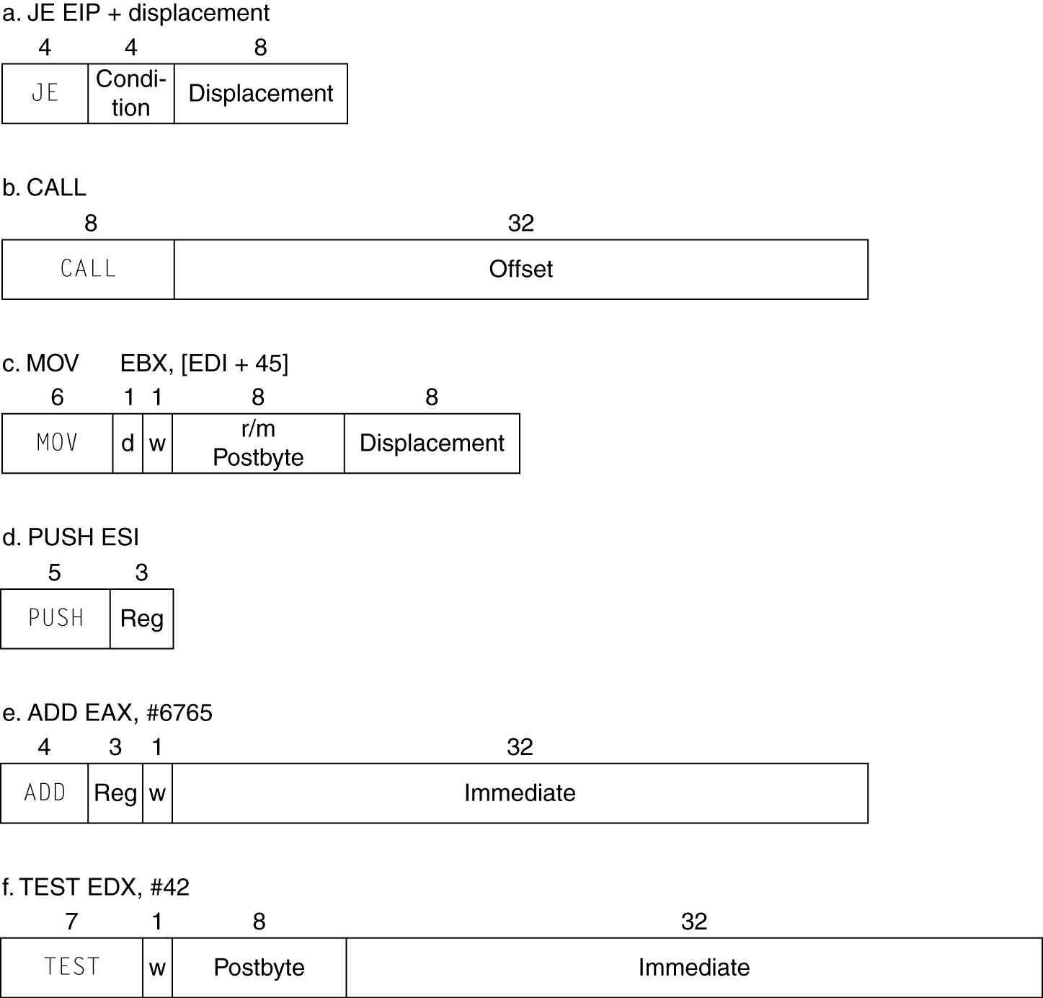
x86 Instruction Encoding
Variable length encoding
Postfix bytes specify addressing mode
Prefix bytes modify operation
Operand length, repetition, locking, …

Slide 90
Implementing IA-32
Complex instruction set makes implementation difficult
Hardware translates instructions to simpler microoperations
Simple instructions: 1–1
Complex instructions: 1–many
Microengine similar to RISC
Market share makes this economically viable
Comparable performance to RISC
Compilers avoid complex instructions

Slide 91
ARM v8 Instructions
In moving to 64-bit, ARM did a complete overhaul
ARM v8 resembles MIPS
Changes from v7:
No conditional execution field
Immediate field is 12-bit constant
Dropped load/store multiple
PC is no longer a GPR
GPR set expanded to 32
Addressing modes work for all word sizes
Divide instruction
Branch if equal/branch if not equal instructions
§2.18 Real Stuff: ARM v8 (64-bit) Instructions

Slide 92
Fallacies
Powerful instruction ⇒ higher performance
Fewer instructions required
But complex instructions are hard to implement
May slow down all instructions, including simple ones
Compilers are good at making fast code from simple instructions
Use assembly code for high performance
But modern compilers are better at dealing with modern processors
More lines of code ⇒ more errors and less productivity
§2.19 Fallacies and Pitfalls

Slide 93
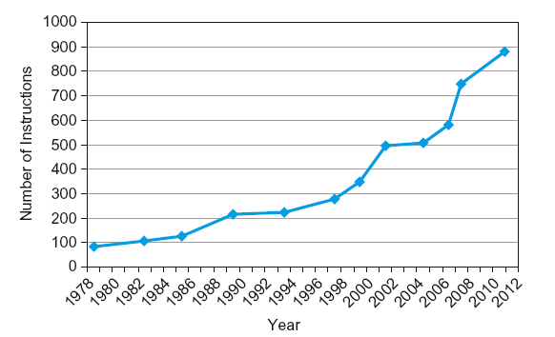
Fallacies
Backward compatibility ⇒ instruction set doesn’t change
But they do accrete more instructions
x86 instruction set

Slide 94
Pitfalls
Sequential words are not at sequential addresses
Increment by 4, not by 1!
Keeping a pointer to an automatic variable after procedure returns
e.g., passing pointer back via an argument
Pointer becomes invalid when stack popped

Slide 95
Concluding Remarks
Design principles
1. Simplicity favors regularity
2. Smaller is faster
3. Make the common case fast
4. Good design demands good compromises
Layers of software/hardware
Compiler, assembler, hardware
MIPS: typical of RISC ISAs
c.f. x86
§2.20 Concluding Remarks

Slide 96
Concluding Remarks
Measure MIPS instruction executions in benchmark programs
Consider making the common case fast
Consider compromises
Instruction class | MIPS examples | SPEC2006 Int | SPEC2006 FP
Arithmetic | add, sub, addi | 16% | 48%
Data transfer | lw, sw, lb, lbu, lh, lhu, sb, lui | 35% | 36%
Logical | and, or, nor, andi, ori, sll, srl | 12% | 4%
Cond. Branch | beq, bne, slt, slti, sltiu | 34% | 8%
Jump | j, jr, jal | 2% | 0%

